Slide 1


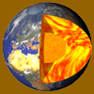

EIGEN-6C4
The latest combined global gravity field model including GOCE data up to degree and order 2190 of GFZ Potsdam and GRGS Toulouse
Ch. Förste¹, S.L. Bruinsma², O. Abrikosov¹, J.-M. Lemoine², T. Schaller³, H.-J. Götze³, J. Ebbing³, J.C. Marty², F. Flechtner¹, G. Balmino² and R. Biancale²
¹GFZ Potsdam, Dept. Geodesy and Remote Sensing, Telegrafenberg, D-14473 Potsdam, Germany (e-mail: foer@gfz-potsdam.de)
²CNES/GRGS, 18, avenue Edouard Belin, F-31055 Toulouse, France (e-mail: sean.bruinsma@cnes.fr)
³Department of Geosciences, Kiel University, D-24118 Kiel, Germany (e-mail: jebbing@geophysik.uni-kiel.de)

Slide 2
Introduction
GFZ Potsdam and GRGS/CNES Toulouse have a long-time close cooperation in the field of global gravity field determination which presently focuses among others on:
GOCE gravity field determination (“Direct Approach”): behalf of ESA and in the framework of the GOCE High Level Processing Facility” (GOCE-HPF), the latest release is GO_CONS_GCF_2_DIR_R5 (Bruinsma et al. 2014)
Computation of high resolution global gravity field models incl. GOCE SGG data:
EIGEN*-6C (2011, Shako et al. 2013, max. d/o 1420)
EIGEN-6C2 (2012, Förste et al. 2012, max. d/o 1949)
EIGEN-6C3 (2013, Förste et al. 2013, max d/o 1949), was taken as basis for the new Canadian Hight Reference System: Canadian Gravimetric Geoid CGG2013
Subject of this presentation: EIGEN-6C4 (max d/o 2190), the latest release of the EIGEN-6C-Series, containing the complete SGG data of the GOCE-Mission
* EIGEN = “European Improved Gravity model of the Earth by New techniques”

Slide 3
Data used for EIGEN-6C4
LAGEOS-1/2 SLR data:
1985 – 2010 of GRGS release 2 normal equations to degree/order 30
GRACE GPS-SST and K-band range-rate data:
Feb 2003 – Dec 2012 of GRGS release 3 normal equations to degree 175
GOCE data:
- SGG data (Txx, Tyy, Tzz, Txz) from 01 November 2009 – 20 October 2013
- weighting per measurement (based on RMS of residual), cos-latitude weighting
- individual normal equations for each SGG component (4) up to degree/order 300
- application of a (120 – 8) s band-pass filter for all four SGG components
→ The satellite data are the same as used for GO_CONS_GCF_2_DIR_R5
Surface data:
DTU 2’x2’ global gravity anomaly grid (Anderson, 2010)
= altrimetry over the oceans, EGM2008 (Pavlis et al. 2012) over continents
Block diagonal solution for degrees 371-2190
The combination of the different satellite and surface parts is done by a band-limited combination of normal equations, as a function of their resolution and accuracy (c.f. Förste et al. 2008).

Slide 4
Combination scheme of the normal equations for EIGEN-6C4
Accumulation of a full normal matrix up to d/o 370:
~200.000 parameters, ~ 250 GByte
contribution to the solution EIGEN-6C4:
elminated beforehand (block matrix reduction):
Separate block diagonal solution:
Spherical harmonic degree
2
30
235
260
370
2190
LAGEOS
130
150
175
GRACE
GOCE SGG Txx + Tyy + Tzz + Txz
Terrestrial data (DTU + EGM2008)
DTU + EGM2008

Slide 5
EIGEN-6C4 – Spectral behaviour

Slide 6
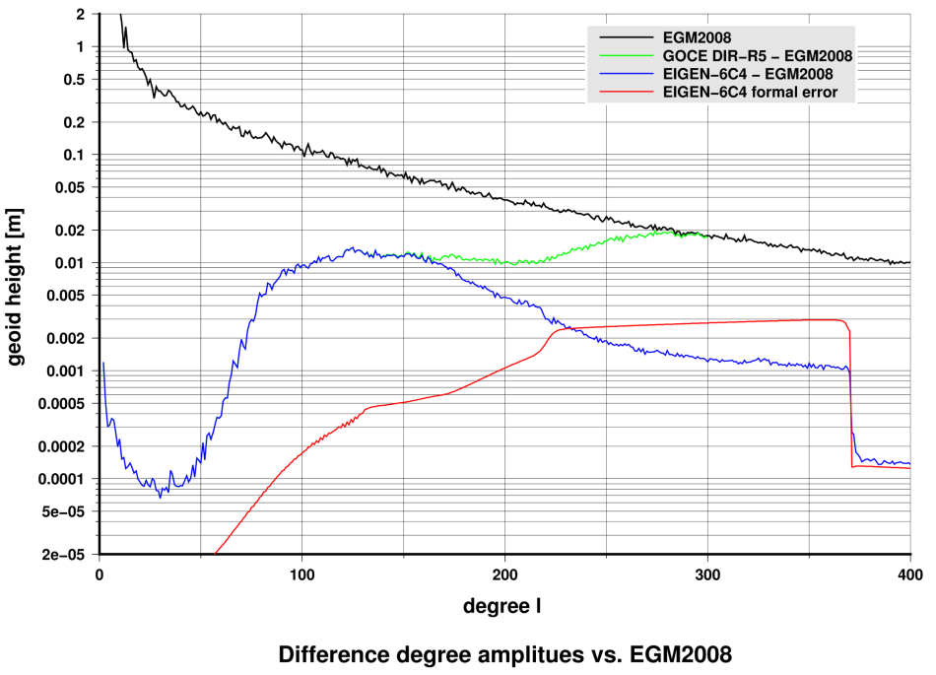
Spectral evaluation – difference degree amplitudes
Spectral evaluation – difference degree amplitudes to EGM2008 (1)

Slide 7
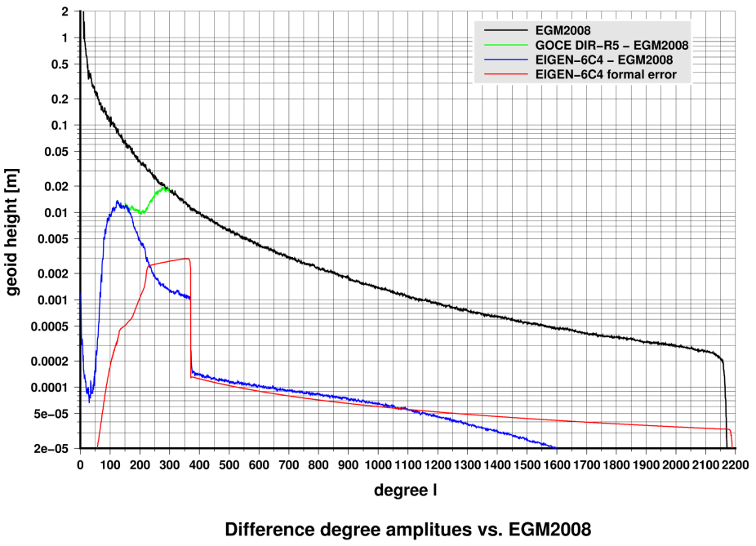
Spectral evaluation – difference degree amplitudes to EGM2008 (2)

Slide 8
EIGEN-6C4 – Evaluation

Slide 9
GPS/Levelling test with EIGEN-6C4
Comparison with geoid heights determined point-wise
by GPS positioning and levelling:
Root mean square (cm) about mean of GPS-Levelling minus
model-derived geoid heights (number of points in brackets).
GPS/Leveling fit in cm up to d/o 2190
EGM2008 EIGEN-6C4
Europe (1234) 20.7 20.9
Germany (675) 4.3 4.8
Canada (1930) 12.6 12.4
USA (6169) 24.6 24.5
Australia (201) 21.5 21.1
Japan (816) 8.2 7.8
Brasil (672) 36.6 30.6
Sources/References for the used GPS/Lev data:
- USA: (Milbert, 1998)
- Canada: (M. Véronneau, personal communication 2003, Natural Resources Canada)
Europe/Germany: (Ihde et al., 2002)
Australia: (G. Johnston, Geoscience Australia and W. Featherstone, Curtin University
of Technology, personal communication 2007)
- Japan: (Tokuro Kodama, Geospatial Information Authority of Japan, personal
communication 2013)
- Brazil: Denizar Blitzkow and Ana Cristina Oliveira Cancoro de Matos, Centro de Estudos de Geodesia (CENEGEO),
personal communication, the data belongs to the Brazilian Institute of Geography and Statistics (IBGE)

Slide 10
GOCE and CHAMP Orbit adjustment tests
Observations: Kinematic GOCE (Bock et al. 2011) and CHAMP (Prange et al. 2010) orbit positions
Dynamic orbit computation
GOCE: 60 arcs (01.11. – 31.12.2009), Arclength = 1.25 days
CHAMP: 75 arcs (01.02. – 01.05.2008), Arclength = 1.0 day
Parametrization for GOCE (this is similar for CHAMP):
- Accelerometer biases: 2/rev for cross track / radial / along track
- Accelerometer scaling factor: along track fixed (set to 1.0), 1/arc for cross track / radial
Rms values [cm] of the orbit fit residuals (mean values for the 75/60 arcs)
Gravity Field Model | GOCE Max d/o 180 x 180 | CHAMP Max d/o 150 x 150
EGM2008 (Pavlis et al. 2012) | 2.79 | 2.68
GIF48 (Ries et al. 2011) | 1.64 | 2.52
GOCO03S (Mayer-Gürr et al. 2012) | 1.64 | 2.55
GO_CONS_GCF_2_DIR_R3 | 1.60 | 2.50
GO_CONS_GCF_2_DIR_R4 (Bruinsma et al. 2013) | 1.58 | 2.50
GO_CONS_GCF_2_TIM_R4 | 1.52 | 8.84
GO_CONS_GCF_2_TIM_R5 (Brockmann et al. 2014) | 1.52 | 7.18
GO_CONS_GCF_2_DIR_R5 (Bruinsma et al. 2014) | 1.51 | 2.50
EIGEN-6C3stat | 1.55 | 2.50
EIGEN-6C4 | 1.50 | 2.50
EIGEN-6C4 gives the best orbit fits for GOCE
The best CHAMP orbit fits for EIGEN-6C4, EIGEN-6C3 and the three GOCE models of the Direct Approach
Worse CHAMP orbit fit results for the timewise models due to the GOCE polar gaps
→ the TIM-models are not good for orbit computations in general
Notes:
The message:
EIGEN-6C3 is better than DIR-4 in GOCE orbit tests
The best GOCE orbit fit for TIM-4, but this model is extremely bad for CHAMP (→ not good modelling of the polar caps in TIM-4)
The best CHAMP orbit fit for DIR-4 and EIGEN-6C3stat
CHAMP orbits tests have not yet been computed for GIF48 and DIR-3

Slide 11
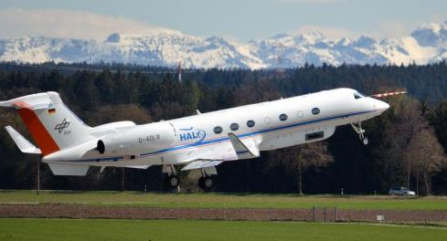
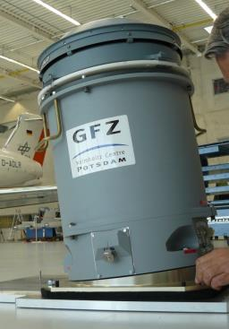
EIGEN-6C4
Comparison with GEOHALO Airborne Gravimetry
HALO – the German High Altitude and LOng Range Research Aircraft (HALO).
GEOHALO –
Multidisciplinary geoscientific airborne mission on the HALO aircraft over Italy June 2012
GFZ‘s airborne gravimeter on HALO:
CHEKAN - AM

Slide 12
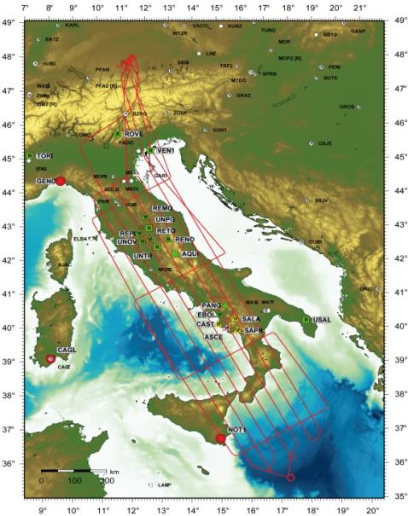
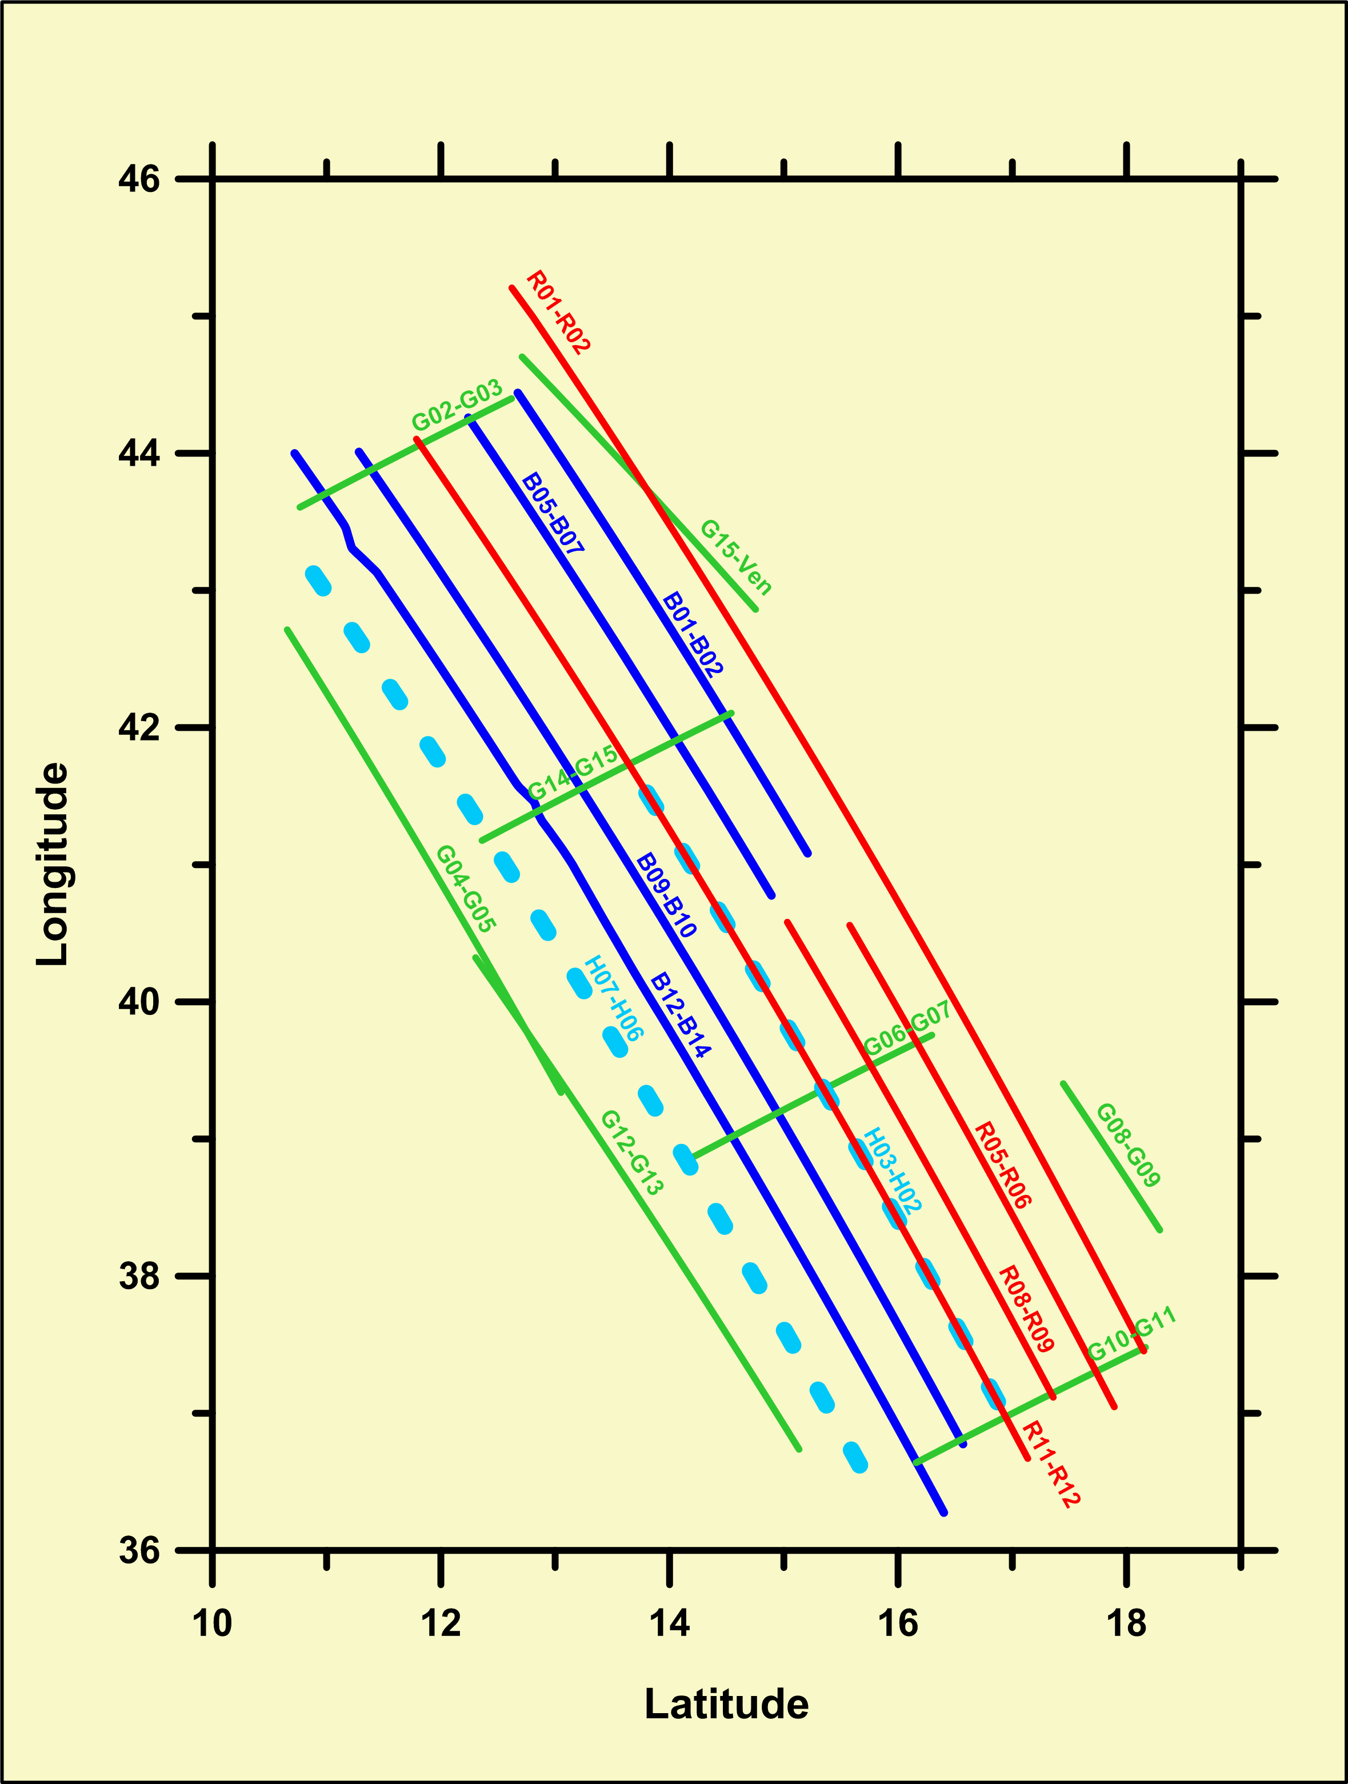
The GEOHALO flight tracks over Italy (June 2012)
The GEOHALO flight tracks where gravimetry has been processed
Example track „R01-R03“
GEOHALO flight characteristics
Flight altitude: 3500 m
Speed: 120 m/s (425 km/h)
Application of a low-pass filter:
cut-off period 260s → ~15 km spatial resolution along track

Slide 13
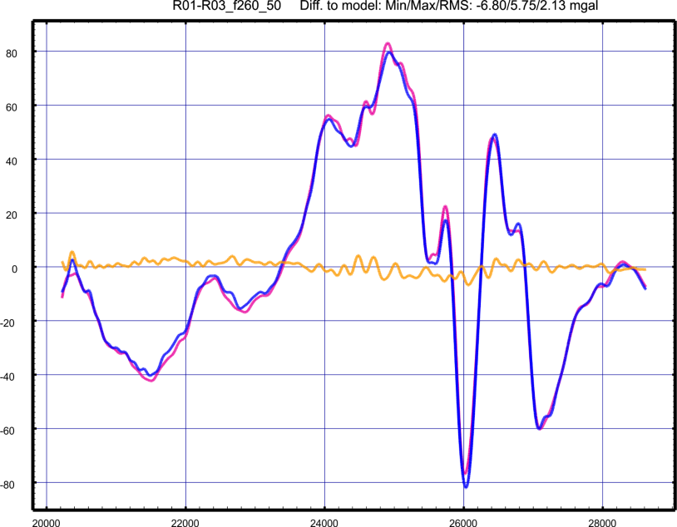
Comparison of the track „R01-R03“
to EGM2008 at flight altitude
GEOHALO
EGM2008
Difference

Slide 14
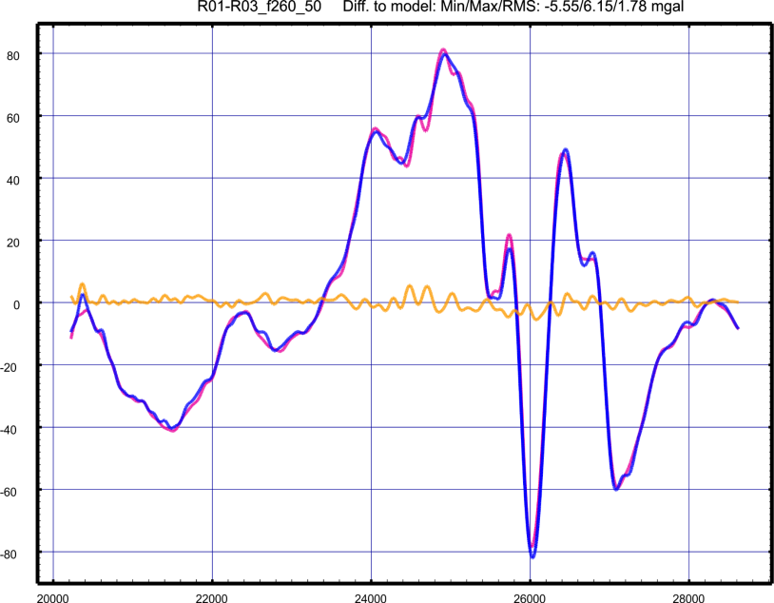
Comparison of the track „R01-R03“
to EIGEN-6C4 at flight altitude
GEOHALO
EIGEN-6C4
Difference

Slide 15
Statistics (mGal) of all GEOHALO airborne gravimetry tracks:
Fit of the measured gravity at flight altitude
to EGM2008 and EIGEN-6C4
========================================================================= Profile #obs Track Min Max RMS Min Max RMS length[km] ---- eigen-6c4 ---- ----- egm2008 ----- ========================================================================= G04-G05 3001 360 -4.54 3.33 1.54 -3.00 3.98 1.32 G06-G07 2101 250 -7.32 3.09 1.83 -7.58 3.01 1.97 G08-G09 1081 130 -6.47 4.13 1.63 -6.53 4.10 1.59 G10-G11 1921 230 -2.35 3.99 1.14 -3.20 3.06 1.06 G12-G13 3421 410 -4.31 8.76 1.98 -5.09 8.15 1.98 G14-G15 1981 240 -6.71 5.98 2.65 -7.22 5.52 2.66 G15-Ven 2101 250 -6.08 5.76 2.03 -7.17 5.83 2.11 R01-R03 8401 1010 -5.55 6.15 1.78 -6.80 5.75 2.13 R05-R06 3901 468 -12.61 8.85 2.82 -14.78 7.63 2.72 R08-R09 3961 470 -6.78 7.61 2.69 -7.02 7.08 2.63 B01-B03 4201 504 -9.96 13.72 3.24 -11.43 11.09 3.39 B09-B10 5101 612 -7.17 11.82 2.82 -6.24 11.80 2.67 B12-B14a 5161 619 -11.81 11.32 2.96 -12.99 9.68 3.09 B12-B14b 1201 144 -8.23 8.94 3.71 -7.93 9.76 3.81 H07-H06 6661 800 -13.52 9.68 2.73 -14.84 8.38 2.77 H03-H02 4681 562 -9.82 8.66 2.48 -9.24 8.81 2.57 Overall RMS (58876 points/7065 km): 2.50 2.55 =========================================================================
´GEOHALO flight characteristics
Flight altitude: 3500 m
Speed: 120 m/s (425 km/h)
Application of a low-pass filter:
cut-off period 260s → ~15 km spatial resolution along track

Slide 16
EIGEN-6C4
Application in 3D density modelling

Slide 17
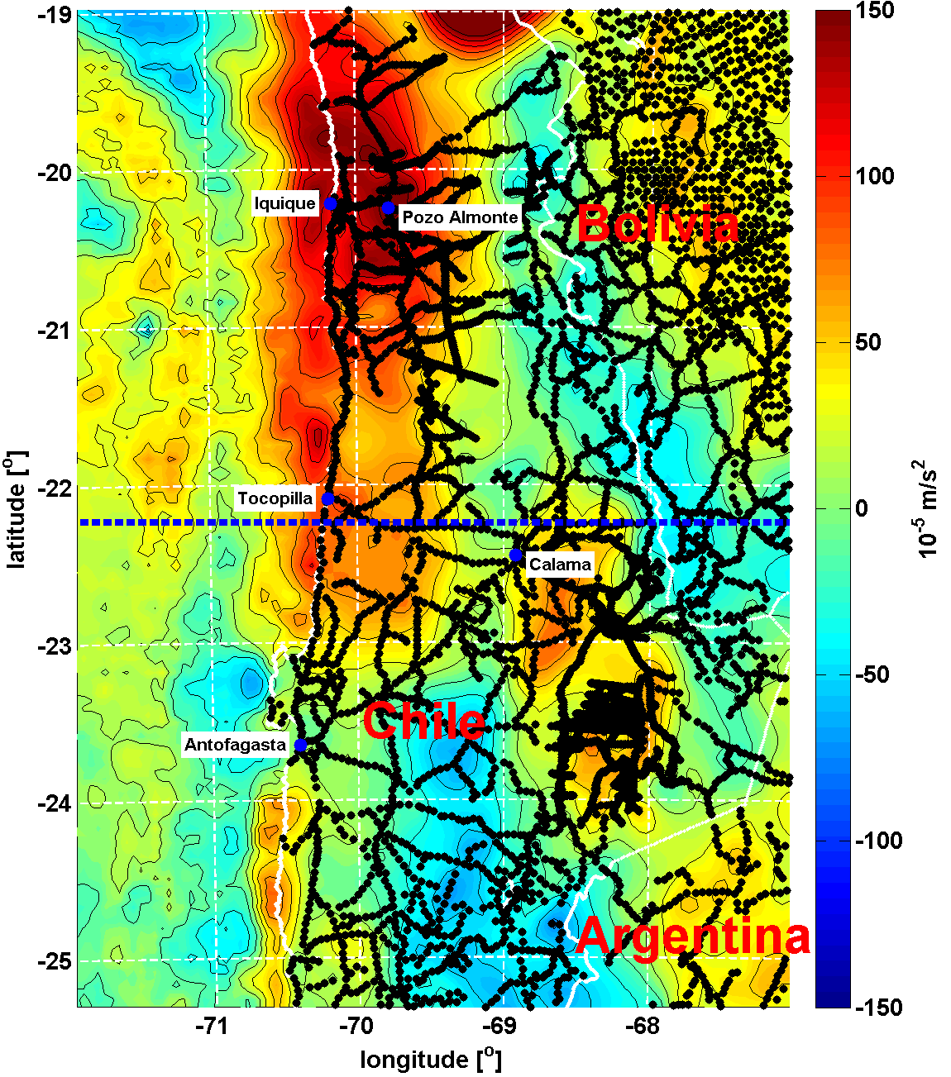
Application of EIGEN-6C4 in density modelling for the Earth‘s crust and mantle
3D-Density modelling over South America
Isostatic Residual Gravity Anomaly
Example: Profile at 22.2° South over South America
Input Gravity Data:
Terrestrial Gravimetry (black dots, Götze et al. 1988 - 2006)
Satellite Altimetry (Anderson & Knudsen 1998))
Constraining Data:
Magnetotelluric
Seismic (refraction & reflexion)
Earthquake hypocentres
Heat flow data
Geological information
Modelling Software:
IGMAS+ (Schmidt & Götze Univ. Kiel together with Transinsight Dresden)

Slide 18
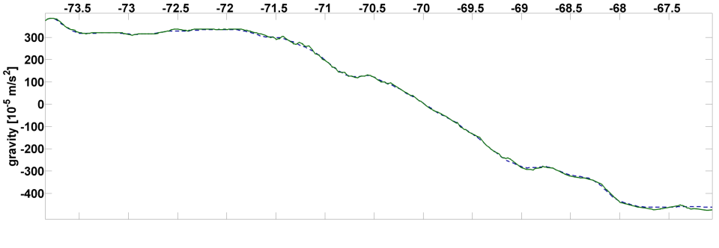
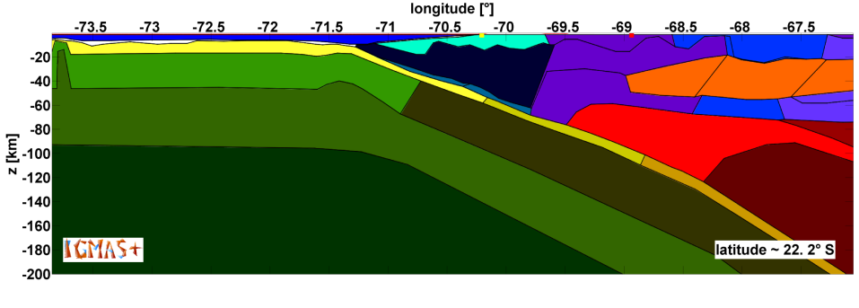
Previous density model from terrestrial data (Schaller, 2013; Diploma thesis)
Measured Gravity
Bouguer anomaly data:
Calculated Gravity
From the measured terrestrial data
Calculated from the density model

Slide 19
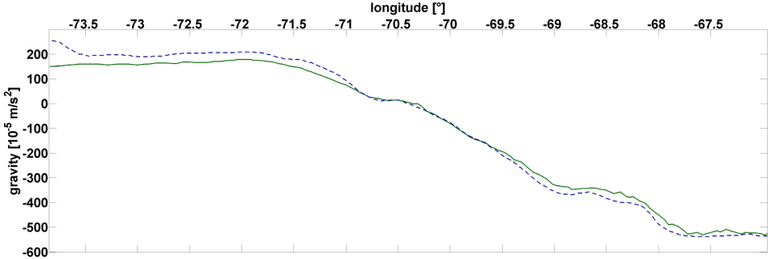
Previous density model – Gravity calculated for EIGEN-6C4 data
~ 50 mGal
Measured Gravity
Calculated Gravity
Bouguer anomaly data:
Gravity data from EIGEN 6C4
Calculated from the density model

Slide 20
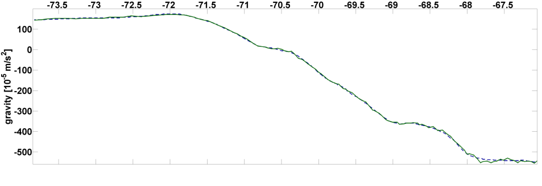
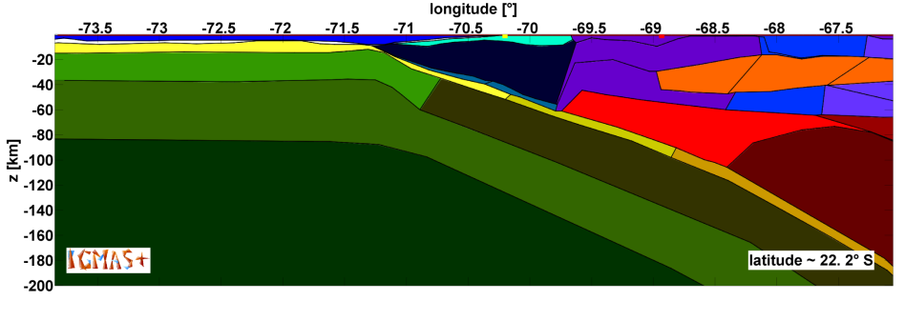
Modified density model fitted to EIGEN-6C4
Measured Gravity
Calculated Gravity
Bouguer anomaly data:
From EIGEN-6C4
Calculated from the modified density model

Slide 21


Comparison: Previous and modified density models
5
1
3
4
2
6
Old model
The verification of these model modifications based on EIGEN-6C4 is subject for further investigations, mainly by using seismological data
5
1
3
4
2
6
New model (modification with EIGEN-6C4)
Modifications:
1 Depth of the boundary between upper and lower oceanic mantle lithosphere
2 Depth of the boundary between oceanic mantle lithosphere and asthenosphere
3 Strong inhomogenity in mantle lithsosphere of the old model
4 Geometry of the upward bulge of the downgoing plate
5 Smoothing of the boundary between upper and middle continental crust
6 Geometry of the asthenospheric wedge (on some model sections the size changed significantly)

Slide 22
Conclusion/Summary
EIGEN-6C4 is a new Global Combined Gravity Field model to degree/order 2190
This model has been inferred from the combination of LAGEOS, GRACE, GOCE and DTU ground data
EIGEN-6C4 contains the complete SGG data of the GOCE mission.
On the continents for wavelengths beyond spher. harm. degree 235, EIGEN-6C4 is basically a reconstruction of EGM2008
The final version of EIGEN-6C4 is downloadable at the ICGEM data base at GFZ Potsdam
http://icgem.gfz-potsdam.de

Slide 23
Thank you for your attention!

Slide 24
References:
Andersen, O. B. and Knudsen, P.", , 1998, Global marine gravity field from the ERS-1 and Geosat geodetic mission altimetry}", "J. Geophys. Res.", volume="103", number="C4", pages="8129--8137", year="1998", publisher="Wiley Online Library",
Andersen O. B. P. Knudsen and P. Berry. (2009): DNSC08 mean sea surface and mean dynamic topography models, Journal of Geophysical Research, Vol. 114, c11001 12 pp., 2009, doi:10.1029/2008JC005179
Andersen, O. B.,(2010): The DTU10 Gravity field and Mean sea surface (2010), Second international symposium of the gravity field of the Earth (IGFS2), Fairbanks, Alaska
Bock H, Jäggi A, Meyer U, Visser P, van den Ijssel J, van Helleputte T, Heinze M and Hugentobler U (2011), GPS-derived orbits for the GOCE satellite, J Geod (2011) 85:807–818, DOI 10.1007/s00190-011-0484-9
Bruinsma, S. L., J. M. Lemoine, R. Biancale, and N. Vales (2010), CNES/GRGS 10-day gravity field models (release 2) and their evaluation, Adv. Space Res., 45(4), 587–601, doi:10.1016/j.asr.2009.10.012.
Bruinsma, S.-L., Förste,C., Abrikosov, O., Marty, J.-C., Rio, M.-H., Mulet, S., Bonvalot, S. (2013): The new ESA satellite-only gravity field model via the direct approach, Geoph. Res. Lett., DOI 10.1002/grl.50716
Sean L. Bruinsma, Christoph Förste, Oleg Abrikosov, Jean-Michel Lemoine, Jean-Charles Marty, Sandrine Mulet, Marie-Helene Rio, and Sylvain Bonvalot (2014), ESA’s satellite-only gravity field model via the direct approach based on all GOCE data, Geoph. Res. Lett., DOI 10.1002/2014GL062045
Dahle, C., F. Flechtner, C. Gruber, R. König, G. Michalak, and K. H. Neumayer (2012), GFZ GRACE level-2 processing standards document for level-2 product release 0005, Sci. Tech. Rep., Data, 12/02, Potsdam, Germany
Förste, C.; Schmidt, R.; Stubenvoll, R.; Flechtner, F.; Meyer, U.; König, R.; Neumayer, H.; Biancale, R.; Lemoine, J.-M.; Bruinsma, S.; Loyer, S.; Barthelmes, F.; Esselborn, S. (2008): The GeoForschungsZentrum Potsdam / Groupe de Recherche de Géodésie Spatiale satellite-only and combined gravity field models: EIGEN-GL04S1 and EIGEN-GL04C. Journal of Geodesy, 82, 6, 331-346, DOI 10.1007/s00190-007-0183-8
Förste C, S. L. Bruinsma, R. Shako, O. Abrikosov, F. Flechtner, J.-C. Marty, J.-M. Lemoine, C. Dahle, H. Neumeyer, F. Barthelmes, R. Biancale, G. Balmino and R. König (2012), A new release of EIGEN-6: The latest combined global gravity field model including LAGEOS, GRACE and GOCE data from the collaboration of GFZ Potsdam and GRGS Toulouse, Geophysical Research Abstracts Vol. 14, EGU2012-2821-2, EGU General Assembly 2012
Ch. Förste, F. Flechtner, Ch. Dahle, O. Abrikosov, H. Neumayer, Franz Barthelmes, R. König, S.L. Bruinsma, J.C. Marty, J.-M. Lemoine, R. Biancale
EIGEN-6C3 - The latest Combined Global Gravity Field Model incl. GOCE data up to d/o 1949 of GFZ Potsdam and GRGS Toulouse, Abstracts, AGU 2013 Fall Meeting (San Francisco, USA 2013)
G\"otze}, H.-J. and MIGRA-Group","Group updates Gravity Database for central Andes}", "EOS, Trans. Am. Geophys. Un.", "1996", VOLUME "77", number = "19", pages = "181--181", DOI = "10.1029/96EO00121"
Mayer-Gürr, T. and the GOCO consortium (2012), The new combined satellite only model GOCO03s, paper presented at International Symposium on Gravity, Geoid and Height Systems GGHS 2012, Venice, Italy
Prange, L., A. Jäggi, R. Dach, H. Bock, G. Beutler, L. Mervart; 2010: AIUB-CHAMP02S: The influence of GNSS model changes on gravity field recovery using spaceborne GPS. Advances in Space Research, vol.45(2), pp. 215-224, DOI:10.1016/j.asr.2009.09.020
Ries, J.C., S. Bettadpur, S. Poole, and T. Richter (2011): Mean Background Gravity Fields for GRACE Processing, GRACE Science Team Meeting, Austin, TX, 8-10 August 2011
Pavlis, N.K., Holmes, S.A., Kenyon, S.C., and Factor, J.K. (2012), The development and evaluation of the Earth Gravitational Model 2008 (EGM2008), Journal of Geoph. Res., Vol. 117, B04406, doi:10.1029/2011JB008916, 2012
"Schmidt, S. and {G\"otze}, H.-J. "{Bouguer and Isostatic Maps of the Central Andes}", booktitle = "The Andes", "2006", pages = "559--562",publisher = "Springer", doi="10.1007/978-3-540-48684-8_28"
Shako R, Förste C, Abrikosov O, Bruinsma SL, Marty J - C, Lemoine J - M, Flechtner F, Neumayer KH and Dahle C. (2013), EIGEN-6C: A High-Resolution Global Gravity Combination Model Including GOCE Data, in F. Flechtner et al. (eds.), Observation of the System Earth from Space – CHAMP, GRACE, GOCE and future missions, Advanced Technologies in Earth Sciences, DOI: 10.1007/978-3-642-32135-1_20, Springer-Verlag Berlin Heidelberg 2013

